Slide 1
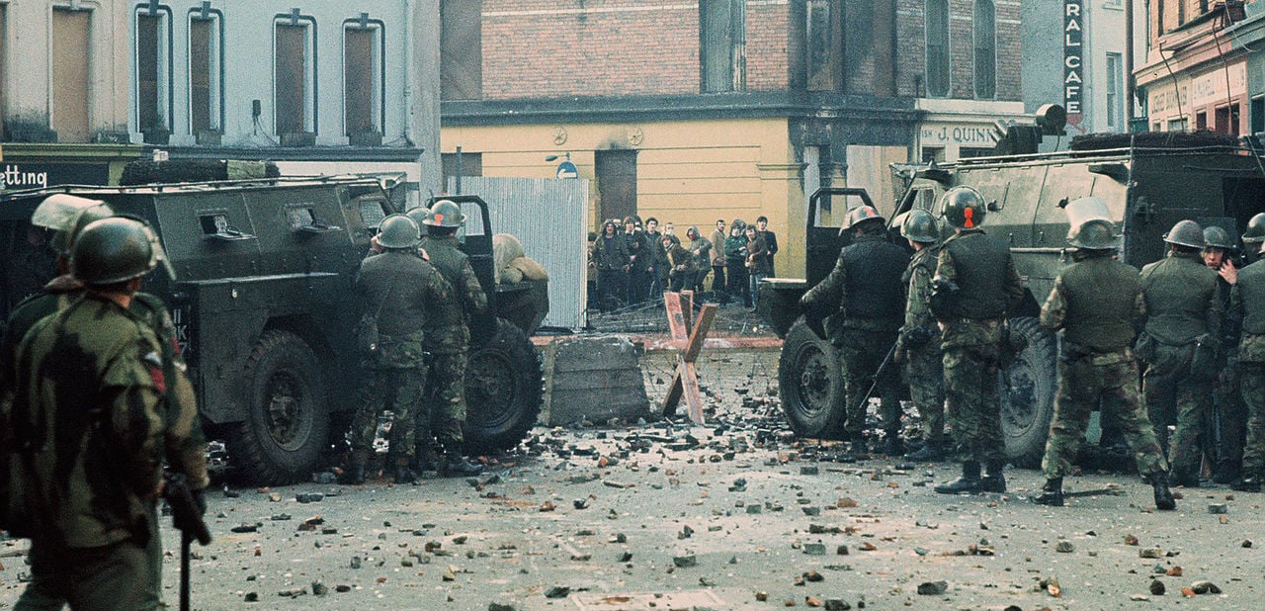
Bloody Sunday – The Spark
The Troubles

Slide 2
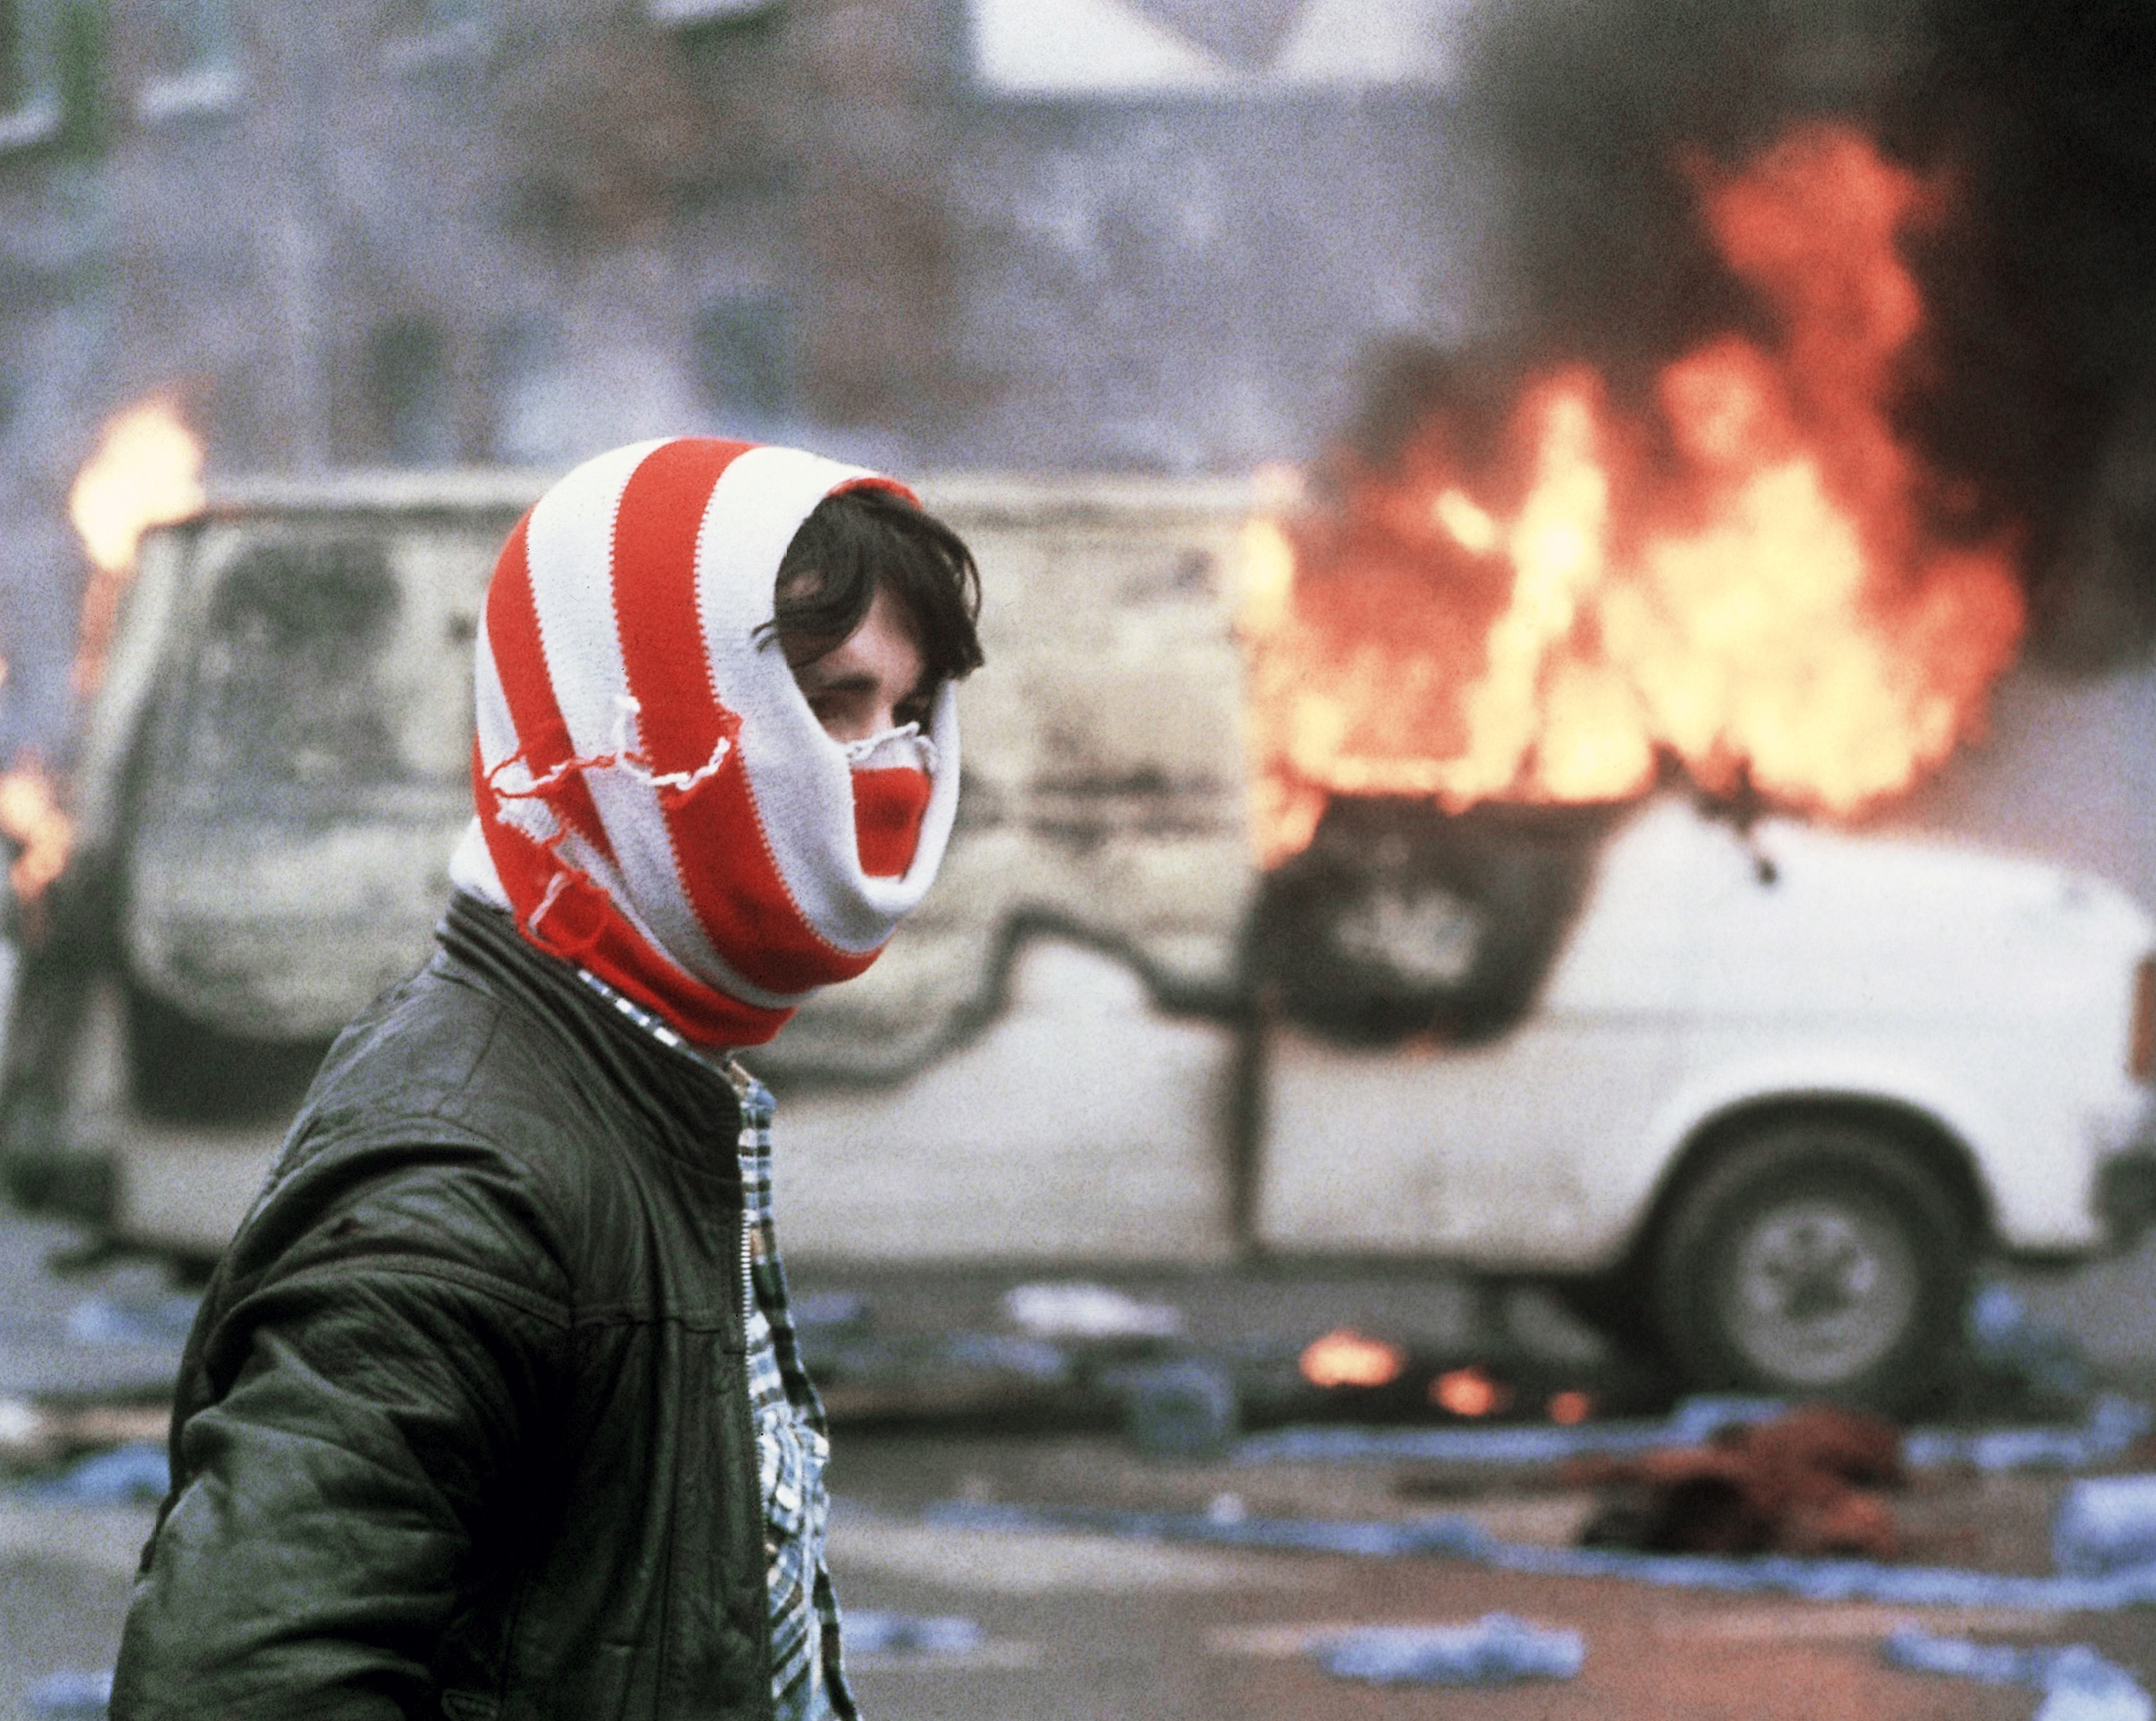
The Conflict:
1960s - 1990s
Nationalists vs. Unionists
Catholic vs. Protestant
Until the Good Friday Agreement, 10 April 1998

Slide 3

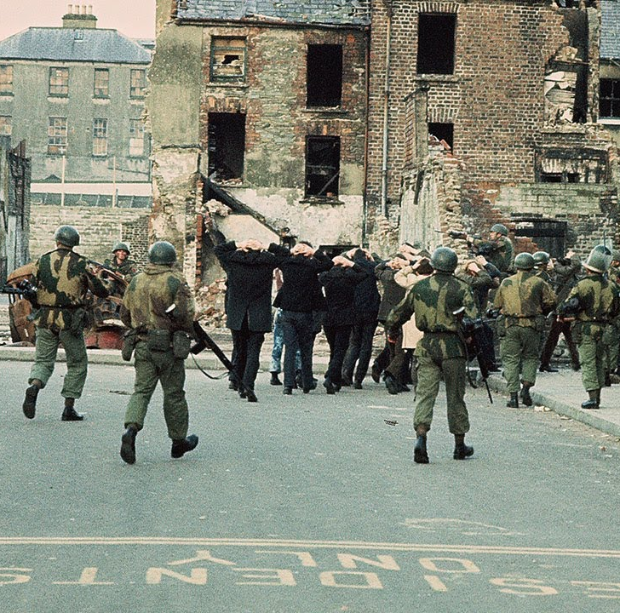
The spark:
Northern Ireland Civil Rights Association (1967)
Battle of the Bogside, 12 to 14 August 1969
The British Army
The Troubles

Slide 4
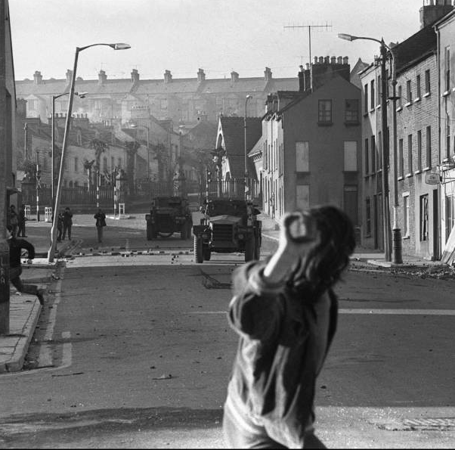
Bloody Sunday:
Sunday 30th January 1972, Londonderry
15,000 people
Protest against internment
Protest technically illegal
1st Battalion, Parachute Regiment
Fourteen killed

